Slide 1
Using IATI Data to Track Multi-Year Funding
May 2023

Slide 2
Summary of this presentation
It’s possible to track most parts of the Grand Bargain Multi-Year Funding commitment, either from the perspective of donors or implementers, using IATI data.
What’s missing: agreeing a methodology for exactly how to use the data to do that. (This presentation proposes a methodology.)

Slide 3
Definitions
What are we trying to measure?

Slide 4
Grand Bargain Commitment
Increase multi-year, collaborative and flexible planning and multi-year funding instruments and document the impacts on programme efficiency and effectiveness, ensuring that recipients apply the same funding arrangements with their implementing partners.
https://interagencystandingcommittee.org/Quality-funding

Slide 5
Characteristics of MYF – caucus definition
1. Duration: 24 months or more at the contract signature, in line with the OECDDAC definition
2. Timeliness: approved funding is advanced to implementing agencies at the beginning of the agreed period, rather than being paid after the period in question
3. Predictability: total funding approved for a multi-year programme should be paid up front wherever possible. Where this is not possible, pre-approved annual tranches should be disbursed, in line with existing guidelines, and as long as contractual obligations are met and funding is available
https://interagencystandingcommittee.org/system/files/2022-07/Grand%20Bargain%20Caucus%20on%20Quality%20Funding%20-%20Outcome%20Document%20-%20final%20-%2011Jul22.pdf

Slide 6
Characteristics of MYF – caucus definition
4. Flexible arrangements: funding should have some of these features –
ability to adapt to changing circumstances and move funds between budget lines and/or sectors of activity, specific locations, delivery modalities, and years; to the extent possible, with no additional pre-approval processes;
smooth and/or fast disbursement of funds;
no-cost extensions available beyond the initial contract duration.

Slide 7
Can IATI data help track MYF commitments?
Duration activities last at least 24 months | YES
2. Timeliness provide funding at the beginning of the agreed period | YES
3. Predictability provide all funding at the beginning of the agreed period | YES
4. Flexibility virement; smooth/fast disbursement of funds; no-cost extensions available | NO*
* except by manually reviewing documents

Slide 8
What to Publish
To track Multi-Year Funding

Slide 9
What to publish – as donors
start and end dates;
outgoing commitments;
disbursements;
implementing organisation (name + ref);
receiver organisations* (name + ref).
* Required, if more than one implementing organisation.

Slide 10
What to publish – as implementers
start and end dates;
incoming commitments;
incoming funds;
provider organisation (name + ref);
provider activity ID*.
* If more than one donor, it might be necessary to look at each donor’s funding instrument for Duration.

Slide 11
How to Track Commitments
Using IATI data

Slide 12
How to Track Commitments Using IATI Data
1. Duration
activities last at least 24 months
Compare end-start dates*; check if they last more than 24 months.
* Use actual dates if available, otherwise use planned dates.

Slide 13
How to Track Commitments Using IATI Data
2. Timeliness + 3. Predictability
amount of funding disbursed at the beginning of the activity
For donors: Compare share of commitments provided as disbursements within [2] quarters of the activity start date.
For implementers: Compare share of incoming commitments provided as incoming funds within [2] quarters of the activity start date, for each donor.

Slide 14
Example: ICRC Ukraine
Duration:
✓ Dates
(less than 24 months)
✘ Provider activity ID
(multi-donor, so need to review donor activity funding instruments)
Timeliness / predictability:
✓ ︎ Incoming commitments
✘ Incoming funds
https://d-portal.org/savi/?aid=XM-DAC-21016-2022-EURASIA-UA

Slide 15
What’s still needed
What’s remaining to do

Slide 16
What: IATI Humanitarian Data Portal
Draft methodology is published
Still needed: update text to cover perspective of implementers
Still needed: broader discussion and agreement on methodology in MYF community
https://humportal.org/guidance/multi-year-funding/

Slide 17
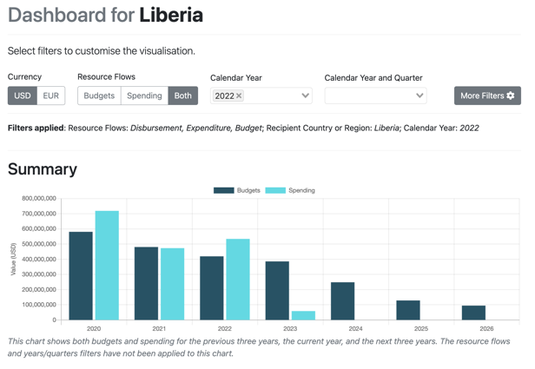
How: Country Development Finance Data
Customise and download simple data extracts
Still needed: view incoming funds* * we are working on this
https://countrydata.iatistandard.org/

